Slide 1
Item/doc 5 – WMO Programmes
Third Session of the Infrastructure Commission
(INFCOM-3, 15-19 April 2024)
J. Hasegawa/Secretariat
15 April 2024

Slide 2
Content
What is proposed
Congress request to the Commission
Why major programmes
Expanded WWW Programme
Scope
Programme components
Implementation activities
Space Programme
Draft Recommendation 5/1

Slide 3
Doc 5 – what is proposed
Draft Recommendation 5/1 - Expanded World Weather Watch Programme and its affiliated programme (the Space Programme) to recommend the new programme description to be considered by the Technical Coordination Committee and adopted by the Executive Council (EC-78/Doc. 4.2 – Major Programmes).
Responding to:
Resolution 42 (Cg-19) - Technical commissions and additional bodies
Resolution 62 (Cg-19) - Review of previous resolutions
Resolution 7 (EC-77) - Subsidiary bodies of the Executive Council

Slide 4
Congress request to the Commission
In Resolution 62 (Cg-19), Congress reviewed and streamlined the foundational elements of the WMO programme structure and decided,
(a) to maintain the World Weather Watch Programme, including components on the WMO Integrated Global Observing System, WMO Information System, WMO Integrated Processing and Prediction System and consolidating the Instruments and Methods of Observation Programme and requested the Infrastructure Commission to develop an expanded programme as an evolution of the World Weather Watch Programme, encompassing the infrastructure needs to cover the entire Earth system; and
(b) to maintain the Space Programme, to coordinate, together with space agencies, the activities of Members to ensure sustained and interoperable satellite observations, enhance capacity building and to promote satellite products and applications and requested the Infrastructure Commission to develop and update the descriptions of the programmes to be maintained in light of the governance reform, the Strategic Plan and other intervening changes.
INFCOM is requested to submit the programme descriptions to the Executive Council at its 78th session (June 2024)
SERCOM has adopted Recommendation 5.1/1 (SERCOM-3) - Weather, Climate, Hydrological, Marine and Related Environmental Services Programme

Slide 5
Why major programmes?
Benefits of defining major programmes
Consolidated view of planning and implementation of component systems
Clear linkage between programme objective and strategy/planning documents of component systems
Clear definition of roles and responsibilities of entities
Members, technical commissions, research board, regional associations and the Secretariat
Alignment of WMO Convention purposes, long-term goals, bodies, major programmes and the Secretariat structure
Tool for communication and relationship with United Nations, other specialized agencies, communities of interest and experts

Slide 6
Programme-related responsibilities of the five organs established by Art. 4(a) of the Convention
Congress
Establishment of scientific and technical programmes (GR 154(2))
Coordinate and organize Members’ activities related to the planning, implementation and evaluation of agreed programmes, strategies and activities;
Identify requirements
among Members and
regional bodies and
communicate them,
together with any impediments to the timely implementation of planned programmes and activities, to the technical commissions; (GR II)
Executive Council
Coordination of programmes and utilization of resources on behalf of Congress (Conv. Art. 14)
Regional
Associations
Technical
Commissions
Implementation and evaluation of the scientific and technical programme activities (GR III)
Daily programme management under the guidance of the Executive Council and in close collaboration with the technical commissions (GR 154(2))
Secretariat
 | 6
Note: the role of the Research Board is currently not reflected in the General Regulations but can be assimilated to that of the technical commissions
Internal Oversight Office
Independent verification of […] operational activities, including programme evaluation, monitoring mechanisms […] (FR 13.7)

Slide 7
Alignment of WMO Convention purposes, long-term goals, bodies, major programmes and Secretariat structures
2 (a) Observation networks
2 (b) Exchange of information
2 (c) Standardization
2 (f) Training
15 (d) Technical information, counsel and assistance
18 Regional associations
Purpose
2 (d) Applications of meteorology
2 (e) Operational hydrology
2 (f) Research
Long-term goal
LTG 1
LTG 2
LTG 3
LTG 4
SERCOM
INFCOM
RB
RAs
Body
EC/CDP
Weather, Climate, Hydrological, Marine and Related Environmental Services Programme
Expanded World Weather Watch Programme
Global Atmosphere Watch
Regional Programme
Major programme
World Weather Research Programme
World Climate Research Programme
Capacity Development Programme
Secretariat structure
Services Department
Infrastructure Department
Science and Innovation Department
Member Services Department

Slide 8
Expanded WWW Programme
Purpose:
Building on the heritage of the World Weather Watch founded in 1963
Responding to the preamble of the WMO convention and its Article 2 (a), (b), (c) and (e);
The objective of the expanded WWW programme is:
Development and implementation of globally coordinated component systems: the WMO Integrated Global Observing System (WIGOS), the WMO Information System (WIS) and the WMO Integrated Processing and Prediction System (WIPPS), for:
Acquiring, processing, transmitting and disseminating Earth system observations, and related standards;
The development and implementation of sound data and information management practices for all WMO Programmes and their associated application and services areas;
The coordination of the production and use of standardized analysis and model forecast fields.

Slide 9
Scope of the expanded WWW Programme
Application areas, including their users
space-based
Weather
Climate
Water
Related
Environmental
Services
Atmosphere
Hydrology
Cryosphere
Ocean
Terrestrial
Space weather
Earth system domains
e.g., quality of air, water, soil;
space weather
surface-based
Photos: Various authors, WMO Calendar Competition 2024, cc
Notes:
Albert (backup: Kruno)

Slide 10
Scope of the expanded WWW Programme
Emphasizing the importance of partnership with non-NMHSs entities, especially in the non-atmospheric Earth system domains.
The Programme includes those activities for assisting programmes of surface and upper-air meteorological and other Earth system observations in areas of global commons: space (through the affiliated Space Programme), the High Seas, and the Antarctic, working with relevant international organizations, as well as the development and implementation of Antarctic regional practices and facilitating the exchange and dissemination of Antarctic data for operational and research purposes.

Slide 11
Expanded WWW Programme
Overall objectives:
Underpinned by the WMO Unified Data Policy
The progrramme ensures the long-term outcomes are reached by 2030:
An integrated Earth system observational network, including on hydrology, ocean, cryosphere, atmospheric composition and space weather, increasingly automated and optimized to ensure effective and sustainable global coverage;
High-quality fit-for-purpose traceable measurements of all components of the Earth System, feeding a continuous free and unrestricted global data exchange in accordance with the WMO Unified Data Policy and underpinned by standardized data management and exchange mechanisms; and
Increasingly more relevant, reliable, and quality assured Earth system numerical analysis and prediction products provided to enable Members to provide required services.
The Programme directly addresses Strategic Objectives 2.1, 2.2 and 2.3 of the WMO Strategic Plan 2024-2027:
2.1 Optimize the acquisition of Earth system observation data through the WMO Integrated Global Observing System (WIGOS);
2.2 Improve and increase access to, exchange and management of current and past Earth system observation data and derived products through the WMO Information System (WIS); and
2.3 Enable access to and use of numerical analysis and Earth system prediction products at all temporal and spatial scales from the WMO Integrated Processing and Prediction System (WIPPS).

Slide 12
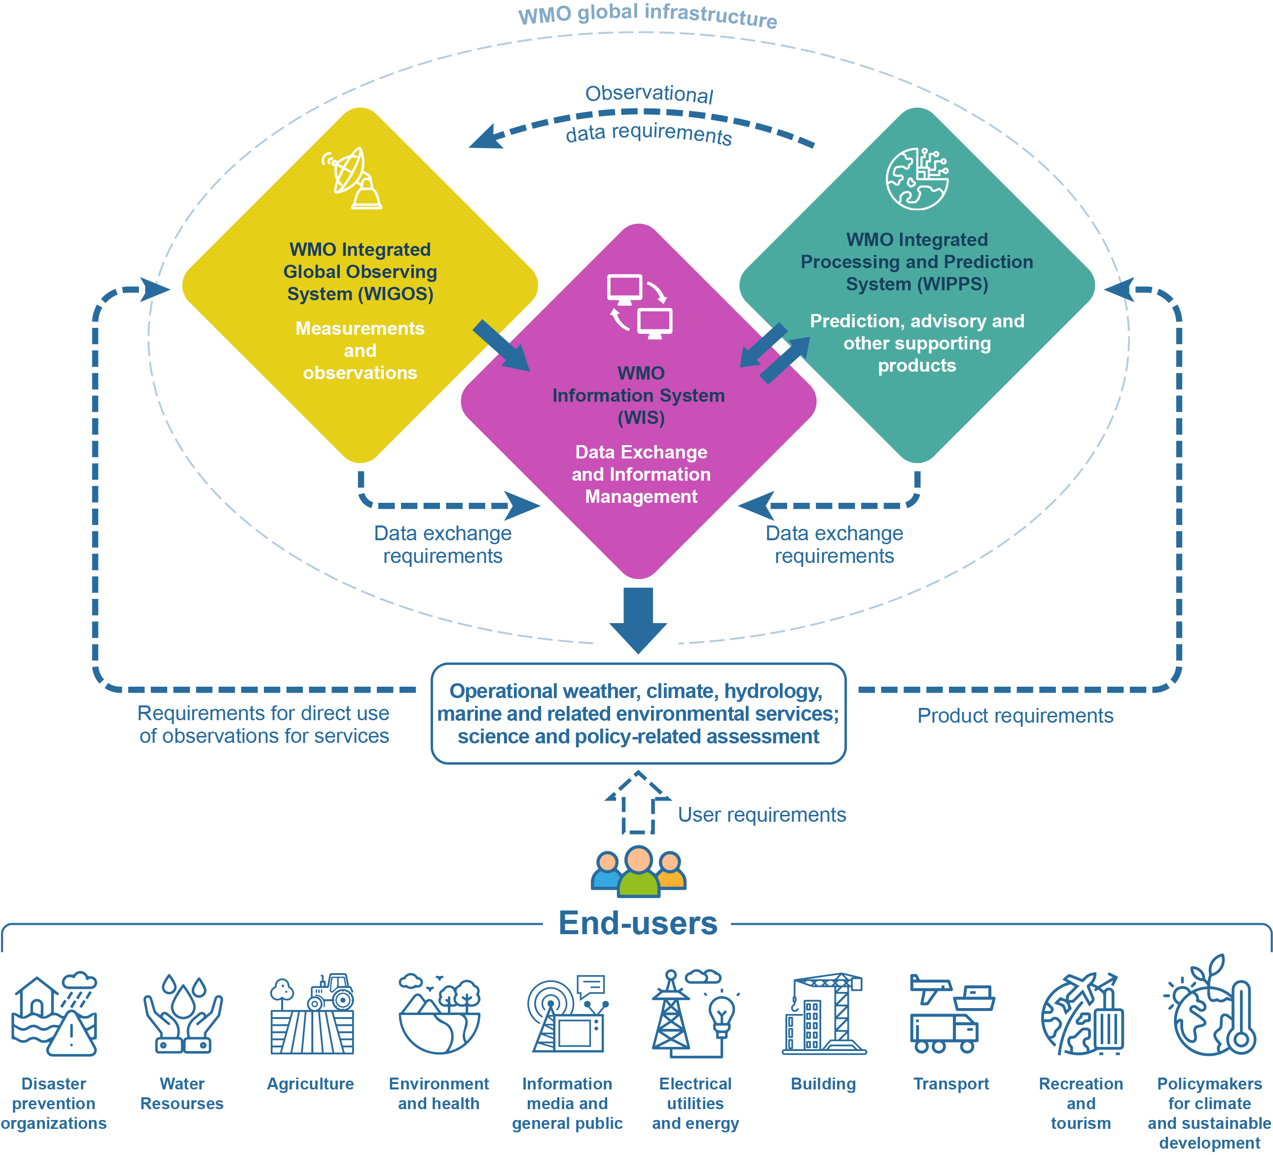
Component systems of the expanded World Weather Watch: the WMO Integrated Global Observing System, the WMO Information System and the WMO Integrated Processing and Prediction System (WMO global infrastructure) – their interrelation and the relation with users

Slide 13
Programme components
Programme component 1: WMO Integrated Global Observing System (WIGOS)
Purpose and scope: responding the Convention Article 2 (a) and (c), with an additional dimension of surface-based (both ground and ocean) and space-based systems (coordinated through the affiliated Space Programme).
Main long-term objective(s) * refer to the WIGOS Vision 2040, the High-Level Guidance, GCOS IP, GOOS 2030 Strategy, WMO-IOC Collaborative Strategy 2022-2025, GAW SIP, Vision and Strategy for Hydrology and Associated Plan of Action
Implementation activities
By Members, INFCOM, SERCOM, RB, RAs and the Secretariat
Programme component 2: WMO Information System (WIS)
Purpose and scope: responding the Convention Article 2 (b)
Main long-term objective(s) * refer to WIS2 Strategy and IP
Implementation activities
By Members, INFCOM, SERCOM, RB, RAs and the Secretariat
Programme component 3: WMO Integrated Processing and Prediction System (WIPPS)
Purpose and scope: responding the Convention Article 2 (a) and (c)
Main long-term objective(s) * refer to the WIPPS collaborative framework, Vision and Strategy for Hydrology and Associated Plan of Action
Implementation activities
By Members, INFCOM, SERCOM, RB, RAs and the Secretariat

Slide 14
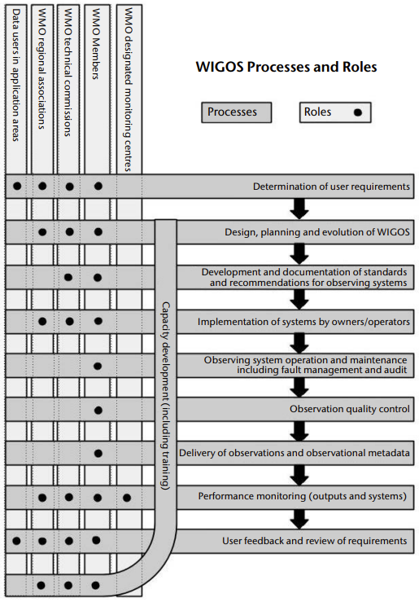
Implementation activities
WIGOS
Implementation, operation, observation quality control, delivery of data/metadata, volunteer for support WDQMS, maintain and develop mutually beneficial relationship at the national level to engage partners, supporting CD
Members
Determine user requirements, design, planning and evolution of WIGOS, develop standards and recommended practices, advocate protection of radio frequencies, performance and compliance monitoring, solicit user feedback and review of requirements, support CD,
Infrastructure Commission
Services Commission
Provide user requirements and feedback
Provide user requirements and feedback
Maintaining dialogue with INFCOM on observing innovation opportunities and needs
Research Board

Slide 15
Implementation activities
WIGOS
Provide user requirements and design for regional priorities
Recommend regional centres to support WIGOS
Develop partnership with regional bodies
Support CD of Members
Regional
Associations
Secretariat
General role of the Secretariat defining by GR
Support the Strategic Plan SO 2.1 and support INFCOM
Liaise with other bodies
Support the maintenance and development of tools with Members to collect and maintain the WIGOS status, progress, performance and compliance monitoring
Support Members on WIGOS implementation
Support CD of Members
Support mutually beneficial engagements
Represent WMO as the technical authority in the SOFF Steering Committee, and act as the liaison between SOFF and INFCOM

Slide 16
Space Programme
WMO Space Programme established by the 14th WMO Congress in 2003.
Purpose and scope:
Together with space agencies, to ensure sustained and interoperable satellite observations, enhance capacity building and to promote satellite products and applications.
It promotes wide availability and utilization of satellite data and products for all the relevant application areas and Earth system domains, and integrates all components required for the provision of operational services within the applicable WMO processes and frameworks.
In particular, the WMO Space Programme coordinates the development of space-based observing system to achieve full implementation of the Vision for WMO Integrated Global Observing System in 2040 (WMO-No. 1243), recognizing the complementary nature of the space-based and surfaced-based components of WIGOS, their individual strengths and limitations, and potential for integration.
Emphasizing the partnership with satellite operating agencies in CGMS and CEOS.

Slide 17
Space Programme
Space Programme activities are in five main areas:
Integrated space-based observing system
Availability and use of satellite data and products
Capacity Building and User Engagement
Space Weather Coordination
Coordination for the use of radio frequency spectrum

Slide 18
Draft Recommendation 5/1
Recalling Resolution 16 (Cg-V), Resolution 62 (Cg-19)
Reaffirming the belief expressed by Resolution 16 (Cg-V)
Affirming that the expanded WWW programme is the basic organizing framework to develop and advance the operational infrastructure facility that is the foundation to all WMO activities and applications;
Recommends to EC the adoption of the programme description of the expanded WWW Programme, as one of the major programmes and the affiliated Space Programme, as part of the resolution to adopt WMO major programmes for the 19th financial period.
Annex: proposed programme description (Annex 2 to draft Resolution 4.2/1 (EC-78))

Slide 19
Thank you.
^{wmo.int}

